Slide 1
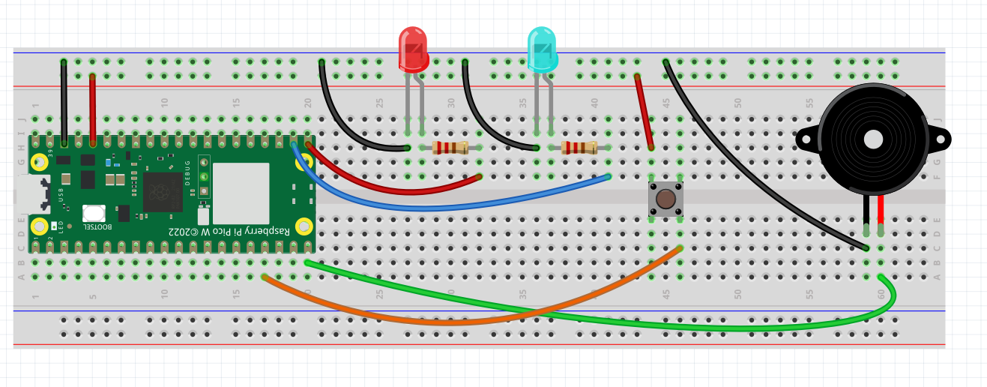
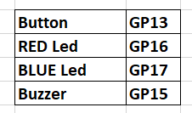
Patrol Car Flashing Lights
PULL_DOWN

Slide 2
ChatGPT Demo
micropython pico w a program with button on Pin 13, red led on Pin 16, blue led on Pin 17 and a buzzer on Pin 15. When button is pressed, flash red and blue led and buzz. use from machine import Pin

